Slide 1




Evaluation of Feedback Mechanisms for Wearable Visual Aids
Aminat Adebiyi, Nii Mante, Carey Zhang, Furkhan E. Sahin, Gerard G. Medioni Ph.D., Armand R. Tanguay Jr. Ph.D. &
James D. Weiland Ph.D.
University of Southern California
7.15.13

Slide 2
Outline
Introduction
Mobility Experiments
  Methods
  Results
Object localization Experiments
  Methods
  Results
Conclusions

Slide 3
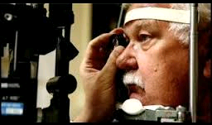
Background
WHO reports 285 million people are visually impaired worldwide, 39 million of which are blind (2012 statistics)
Visual impairment affects mobility, which in turn affects quality of life¹ (n = 3702, α = 0.94; item-total correlation > 0.2)
Mobility aids include the white cane, electronic travel aids and databases of POIs
¹Nutheti et al

Slide 4
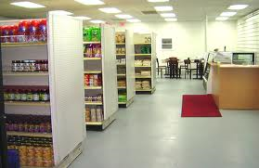
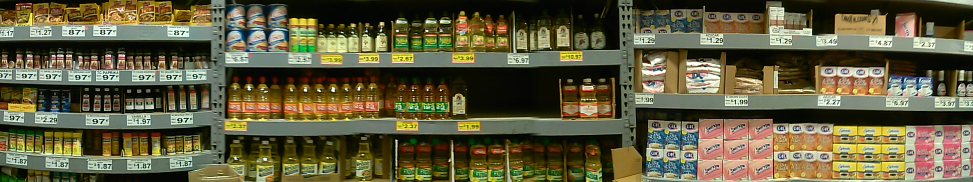
Problem Statement
Current commercially available mobility aids do not provide path planning

Slide 5
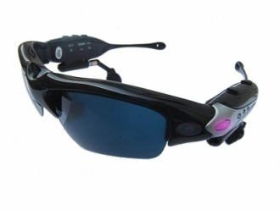
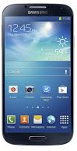
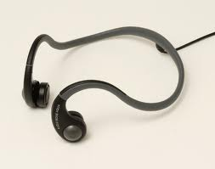
Problem Statement
Our Wearable Visual Aid will provide route planning² and object recognition, localization and tracking
The information provided to the user will be minimized
In this study, we evaluated audio feedback for both mobility and object localization tasks
²Pradeep et al

Slide 6
Mobility Experiments

Slide 7
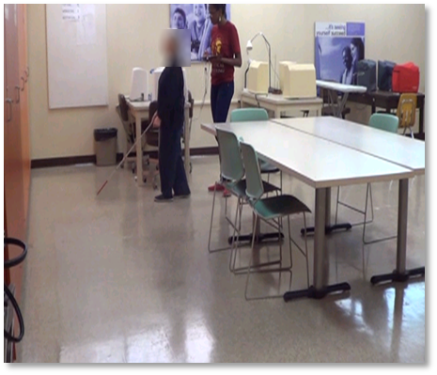
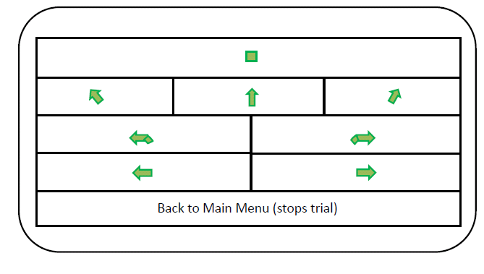
Audio Feedback System for Mobility
Custom Android application delivers verbal commands to the user when an operator presses command button on program
Bone-conduction headphones worn by the user behind the ear
Commands included “forward”, “veer left”, “turn left”, “veer right”, “turn right” and “stop”

Slide 8
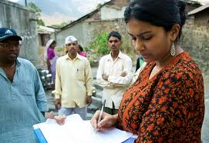
Methods - Mobility
History collected for each subject
Control tests for mobility course (cane only, PWS using sighted guide)
Testing on mobility course (cane + system)
  % correct to cues
  Reaction time
  Percentage preferred walking speed (PPWS)
Exit-survey – System Usability Scale (SUS)
  Measures efficacy, efficiency and satisfaction
  Gives percentage classifying system’s usability

Slide 9
Subject Demographics
Subject | Age (years) | Diagnosis of Visual Loss
RF | 50 | Cytomegalovirus Retinitis
RA | 41 | Advanced Glaucoma
GB | 55 | Microphthalmia/ Anophthalmia
ON | 47 | Retinitis Pigmentosa
JV | 63 | Cataracts
RC | 50 | Diabetic Retinopathy/ Glaucoma
TT | 69 | Retinitis Pigmentosa
NM | 40 | Detached Optic Nerve
HF | 64 | Retinopathy of Prematurity
RT-2 | 40 | Optic Nerve Hypoplasia
Eleven subjects with low vision (best corrected visual acuity of less than 20/60 or visual field less than 90 degrees) recruited from Braille Institute, Los Angeles
  Study approved by the USC-IRB
  Majority had no measurable visual acuity
  Subjects had a mean age of 53.36 years

Slide 10
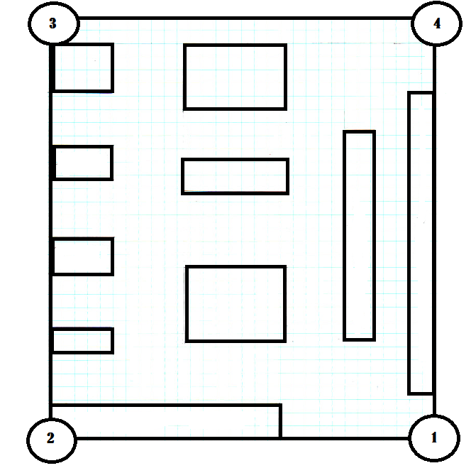
Methods - Mobility
Classroom with tables, chairs and other obstacles
Subjects guided from four predetermined start points to its corresponding diagonal stop point, via three unique routes (12 times total)
As a control, subjects navigated routes with their cane and O&M skills

Slide 11
Results I

Slide 12
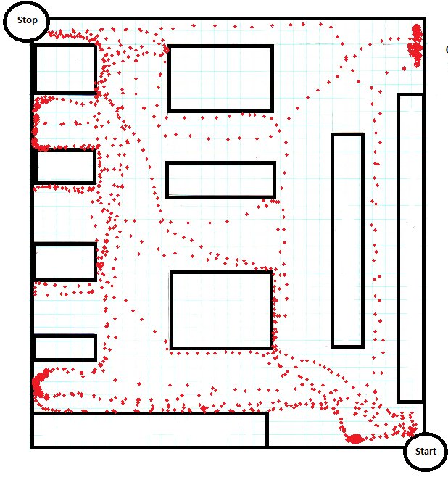
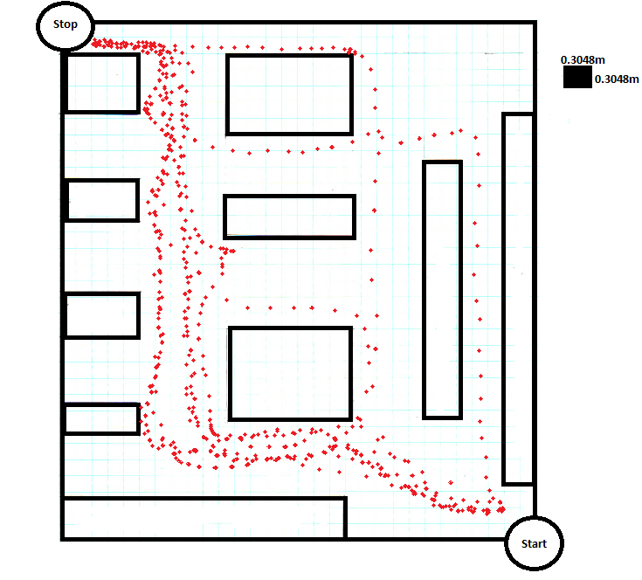
Results - Mobility
Heatmap showing trajectory plotted across all subjects

Slide 13
Results - Mobility
Subject | Average % Compliance | Average Reaction Time (s) | PPWS Control | PPWS MFS | SUS
RF | 84.42% | 1.79 | 35.40% | 39.40% | 95%
RA | 93.92% | 2.02 | 31.20% | 39.80% | 100%
GB | 90.64% | 1.46 | 41.20% | 43.10% | 55%
ON | 85.89% | 1.58 | 42.10% | 43.00% | 95%
JV | 95.79% | 1.73 | 25.10% | 36.70% | 85%
RC | 95.88% | 1.46 | 25.70% | 37.80% | 100%
TT | 98.53% | 1.12 | 45.60% | 48.90% | 100%
NM | 82.02% | 1.19 | 32.50% | 50.60% | 95%
HF | 95.74% | 1.32 | 15.10% | 24.10% | 80%
RT-2 | 96.05% | 1.35 | 23.10% | 39.30% | 97.5%
EB | 100% | 1.17 | 25.30% | 42.30% | 97.5%
Summary | 92.25% | 1.47 | 31.12% | 40.45% | 90.50%
PPWS statistically significant, p < 0.05

Slide 14
Results - Mobility
**Two subjects participated in ten of twelve trials
Pearson product-moment correlation shows no statistically significant relationship between compliance/reaction time and trial number, p > 0.1 (no learning effect)
System can be used in unfamiliar settings

Slide 15
Object Localization Experiments

Slide 16
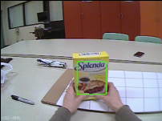
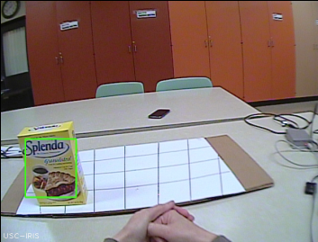
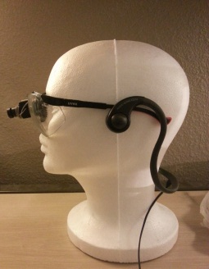
System Flow Chart
Context Tracker (Dinh 2011)
Based upon the TLD Tracker (Kalal 2011)
Uses features of the object + contextual information for robust tracking
Gives us the (x,y) position of the object we’re tracking
Wide Field Camera
Computer/ Algorithms
NO
Object Centered?
(x,y)
Subject turns head
Headphones
Sound Map
Subject Reaches and Grasps for object
YES
Up & Left
Up
Up & Right
“Center”
Left
Center
Right
Model of the Object Localization and Tracking System setup. The subject wears both camera mounted glasses and headphones which are linked to the computer/processor’s algorithms.
Down & Right
Down & Left
Down

Slide 17
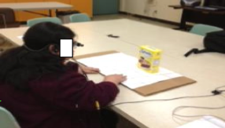
Object Localization Experiments
Patient seated and wearing the camera/feedback system
Researcher starts Context Tracker program and selects the object to track
Two Stages
  Training (localization w/ assistance from Researcher) and Testing (autonomous)
  For one test, user has at most 45 seconds to find the object

Slide 18
Object Localization Experiments
Subject Information
Subject ID | Visual Loss
NM | Bilateral Retinal Detachment (Blind from birth)
EB | Retinitis Pigmentosa (Adult Blindness)
RT-2 | Optic Nerve Hypoplasia (Blind from Birth)
Data measured
  Object Tracking Path
  Time (seconds) to Grasp object
  Success Rate
  System Usability Score (%)

Slide 19
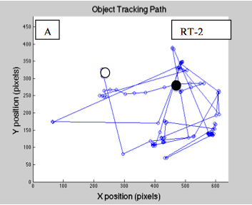
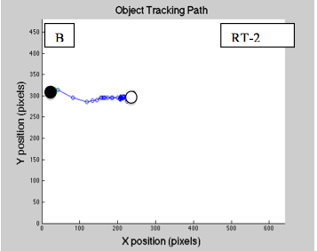
Results – Object Tracking Path
RT-2 Path data for Trials 1 and 10 below
Figure. Trial 1 (Left) and Trial 10 (Right) Essentially, this shows where the object started (black circle) and where the object ended (white circle), and the path the object took in the subjects field of view. The white circle corresponds to when and where the users grasped the object.

Slide 20
Results – Start to Finish

Slide 21
Results – Time, Grasp Success Rate and SUS
Subject ID | Average Time (seconds) | Success % | SUS
NM | 18.6 ± 11.8 | 100% (10 trials) | 67.5%
EB (Day 1) | 9.1 ± 1.7 | 100% (10 trials) | 97.5%
EB (Day 2) | 5.6 ± 2.1 | 100% (10 trials)
EB (Day 3) | 7.4 ± 2.5 | 100% (15 trials)
RT-2 (Day 1) | 13.8 ± 14.1 | 60% (10 trials) | 87.5%
RT-2 (Day 2) | 11.8 ± 5.6 | 100% (10 trials)
RT-2 (Day 3) | 5.1 ± 2.3 | 100% (14 trials)
RT-2 (Day 4) | 10.6 ± 5.8 | 100% (10 trials)
EB days 1-3 trend statistically significant (p < .05)
RT-2 days 1-3 trend statistically significant (p < .05)

Slide 22
Conclusions - Mobility
Mobility
  Audio feedback system improved efficiency and efficacy of subject travel
  All subjects adapted quickly to the verbal commands
  Subjects were enthusiastic about potential commercial availability of a wearable visual aid using an audio feedback mechanism
Object Localization and Tracking
  Subjects were able to successfully reach and grasp for objects with the closed loop Object Localization and Tracking System (OLTS)
  A general trend of improved times shows that subjects can become adept at using the system
audio feedback is a viable mechanism for computer vision based blind assistance

Slide 23
Acknowledgements
Greg Goodrich, Ph.D.
Vivek Pradeep, Ph.D
Paige Sorrentino
Kaveri Thakoor
Matthew Lee
TATRC – Grant # W81XWH-10-2-0076
References
Nutheti et al (2006) Impact of Visual Impairment and Eye Disease in India IOVS, November 2006, Vol. 47, No. 11
Pradeep V, Medioni G, Weiland J. (2010) Robot vision for the visually impaired. CVAVI10:(15-22)

Slide 24
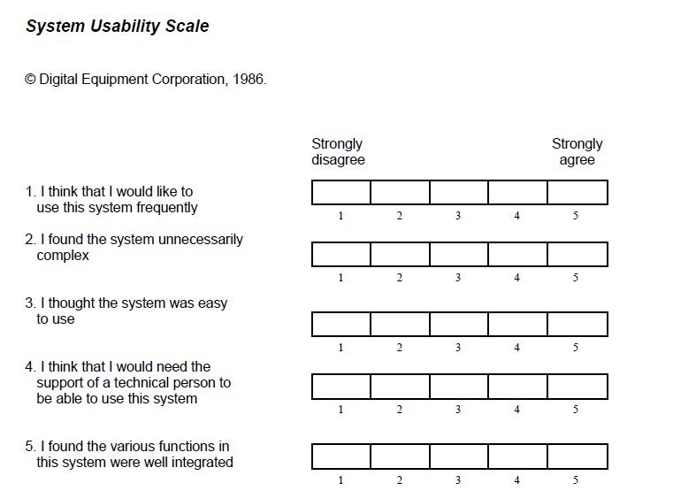
SUS
The system usability score acts as a means to quantify how useable a system is
Ten questions are given to the user
Each question is rated by the user on a scale from 1 to 5, in which 1 corresponds to strongly disagreeing with the question, and 5 corresponds to strongly agreeing with the question

Slide 25
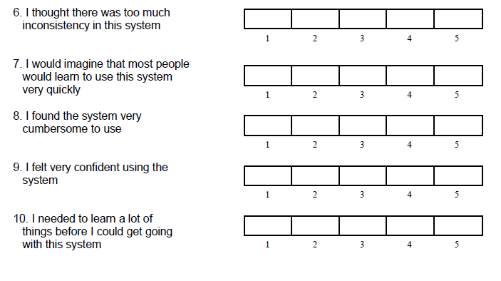
SUS (contd)

